Slide 1


Assessing the Impact of PCSK9 Inhibition on Coronary Plaque Phenotype with Optical Coherence Tomography: Primary results of the HUYGENS Study
Stephen J Nicholls, Thomas Hucko, Steven E. Nissen, Francesco Prati, Stephan Windecker, Yu Kataoka, Rishi Puri, Bei Wang, Julie Butters, Giuseppe Di Giovanni, Stephen Jones and Peter J Psaltis.
SC-AT-AMG145-01161 Sep 2021
This study was funded by Amgen Inc. ClinicalTrials.gov: NCT03570697

Slide 2
Background
Despite the established clinical benefits, many patients are not treated with intensive lipid lowering agents or achieve LDL-C goals after an ACS.
IVUS trials have demonstrated that high intensity statins with and without PCSK9 inhibitors produce plaque regression with the degree of benefit directly proportional to LDL-C lowering.
Plaque vulnerability plays an important role in driving residual CV risk in patients, yet the impact of lipid lowering is unknown.
HUYGENS aimed to determine the impact of adding a PCSK9 inhibitor to statin therapy on plaque phenotype after an ACS.

Slide 3
HUYGENS Study Design
161 patients with (i) NSTEMI, (ii) angiographic CAD, (iii) LDL-C ≥60 mg/dL on high-intensity, ≥80 mg/dL on low/moderate-intensity or ≥130 mg/dL on no statin at screening, (iv) subsequently treated with maximally tolerated statin and (v) target segment on OCT containing at least one image with a FCT ≤120 µm and one image with lipid arc >90º
Screening
Coronary Angiogram
Baseline OCT/IVUS
SC injection of 3 mL placebo
Placebo SC monthly
Randomization 1:1 to study
End of Study OCT/IVUS
Evolocumab 420 mg SC monthly
Screening
Treatment
1 Week
0
4
12
24
36
50
Week
Nicholls Cardiovasc Diag Ther 2021

Slide 4
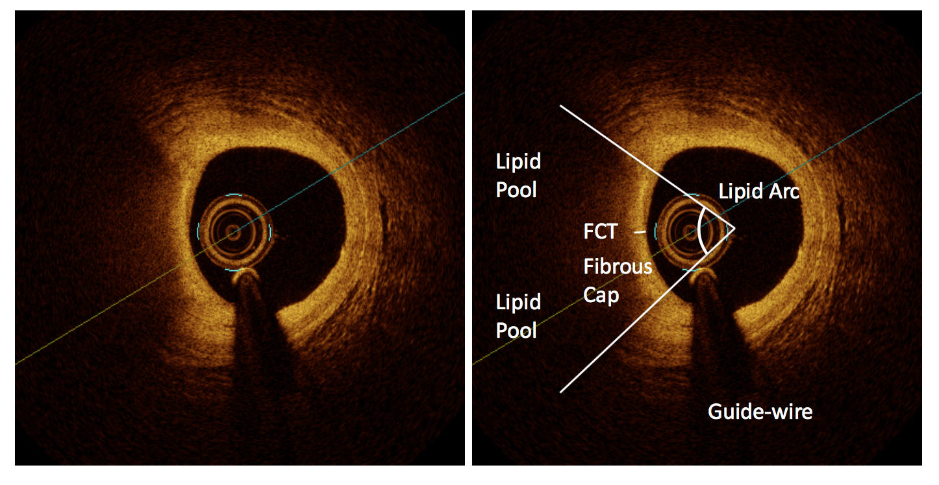
Imaging Analysis
OCT analysis on images 0.2-mm apart in a segment defined by proximal and distal side branches
Primary endpoint: change in minimum FCT anywhere in the segment
Secondary endpoints
  Percent change in minimum FCT
  Change in average minimum FCT
  Change in maximum lipid arc
Plaque analysis: regions containing FCT ≤120μm and lipid arc >90º for ≥3 consecutive images

Slide 5
161 patients at 27 global centers with NSTEMI and LDL-C ≥60 mg/dL on high-intensity,
≥80 mg/dL on low/moderate-intensity or ≥130 mg/dL on no statin at screening.
Coronary angiography showing 20-50% stenosis in a target vessel.
Target segment on OCT containing at least one image with
a FCT ≤120 µm and one image with lipid arc >90º
Optical coherence tomography via motorized pullback
at 0.2 mm/sec through >40 mm segment
Maximally tolerated statin
plus placebo
12 months
treatment
Maximally tolerated statin
plus evolocumab
11 patients did not complete
15 patients did not complete
70 placebo completers
65 evolocumab completers
Follow-up OCT of originally imaged “target” vessel (n=135)

Slide 6
Baseline Demographics and Statin Usage
Characteristic | Placebo (N=81) | Evolocumab (N=80)
Age | 60.2 | 60.9
Male Gender | 67.9% | 75.0%
BMI kg/m² | 28.0 | 28.2
Diabetes | 17.3% | 16.3%
Smoking | 59.3% | 58.8%
Prior statin use >4 weeks | 24.4% | 23.2%
Statin use in trial (at screening) | 96.3% | 93.8%
High intensity | 82.7% | 78.8%
Moderate intensity | 13.6% | 13.8%
Low intensity | 0% | 1.3%

Slide 7
LDL Cholesterol
142.1
140.4
P<0.001
87.2
28.1

Slide 8
Baseline OCT Measures
 | Placebo (n=81) | Evolocumab (n=80)
Minimum FCT (μm) | 54.6 | 56.6
Average min FCT (μm) | 133.6 | 142.3
Maximum lipid arc (º) | 224.8 | 230.2
FCT <65um | 71.6% | 77.5%
Lipid rich plaque* | 91% | 90%
*lipid rich plaque defined as 3 consecutive images containing FCT ≤120μm and lipid arc >90º

Slide 9
HUYGENS Primary Endpoint: Minimum Fibrous Cap Thickness
+42.7
P=0.015
+21.5

Slide 10
HUYGENS Secondary Endpoint: Percent Change Minimum Fibrous Cap Thickness
+81.8
P=0.04
+44.3

Slide 11
HUYGENS Secondary Endpoint:
Mean Minimum Fibrous Cap Thickness
+62.3
P=0.02
+29.8

Slide 12
HUYGENS Secondary Endpoint: Maximum Lipid Arc
-31.4
P=0.04
-57.5

Slide 13
HUYGENS Exploratory Endpoint: Patients with On-Treatment Minimum FCT <65 μm
30.2
P=0.02
12.5

Slide 14
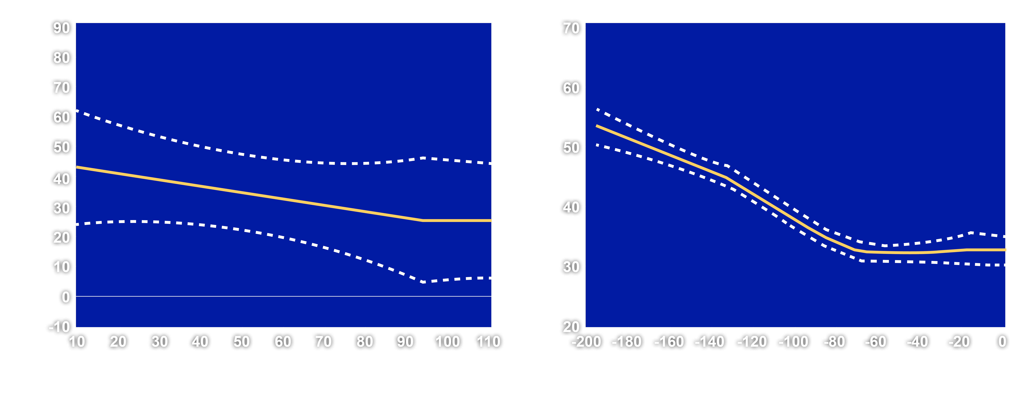
Relationship Between LDL-C and Changes in Fibrous Cap Thickness
Achieved LDL-C
Change in LDL-C

Slide 15
Lipid Rich Plaque Data
 |  | Placebo (n=81) | Evolocumab (n=80) | P Value
Minimum FCT (μm)
 | Baseline (μm) | 52.2 | 53.7
 | Absolute change (μm) | +24.6 | +40.6 | 0.04
Maximum lipid arc (º)
 | Baseline (º) | 229.9 | 238.1
 | Absolute change (º) | -31.9 | -61.9 | 0.02
Lipid length (mm)
 | Baseline (mm) | 14.0 | 15.0
 | Absolute change (mm) | -3.3 | -5.8 | 0.02

Slide 16
Adverse Clinical Events and Safety Findings
Event | Placebo (N=81) | Evolocumab (N=80)
Death | 1.2% | 0%
Nonfatal MI | 3.7% | 0%
Injection site reactions | 1.2% | 0%
Myalgia | 7.4% | 6.3%
Discontinuation from treatment | 12.2% | 4.9%

Slide 17
Conclusions
In patients with a NSTEMI, more intensive lipid lowering with addition of the PCSK9 inhibitor, evolocumab, for 12 months to maximally tolerated statins resulted in greater increases in the minimum FCT and decreases in the maximum lipid arc, both throughout the vessel and within lipid rich plaques.
At 12 months after a NSTEMI only 12.5% of patients treated with evolocumab in addition to maximally tolerated statins demonstrated evidence of any region with a minimum FCT <65 μm, a feature associated with a high risk of plaque rupture.
The degree of benefit was directly proportional to the intensity of lipid lowering observed.

Slide 18
Some Final Thoughts
While the benefits of lipid lowering on plaque burden have been well established, these findings suggest that this can also favorably modulate plaque phenotype and are likely to contribute to early reductions in cardiovascular risk.
The findings suggest that vulnerable plaques can be stabilized after an ACS.
The findings should further motivate the use of intensive lipid lowering regimens in patients following an ACS.

